Slide 1
Analyzing the Growth of Hybrid and Electric Vehicles in the U.S.
Daniel Mihok, Erin Cunningham, Jae Lee, Sirish Kanukunta

Slide 2

Motivations
Global Warming
Electric Vehicle “Hype”

Slide 3
Questions
What is the market share of Plug-in Electric (PEV) and Hybrid Vehicles (HEV) and how does it compare to gas powered cars over time?
Is there an increase or decrease in overall sales of PEVs and HEVs?
What factors affect sales of electric vehicles?
Internal Market Factors
External Market Factors
Is there a correlation between electric vehicle adoption and air pollution levels?

Slide 4
Market Share and Sales Growth of Electric Vehicles
Do we see an increase in sales and market share of electric vehicles?
Data provided by:
D.O.E. Oak Ridge National Laboratory
U.S. Energy Information Administration
Data cleaned and visualized using Pandas and Matplotlib

Slide 5
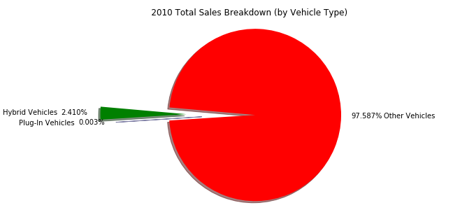
Growth of Hybrid and Electric Vehicle Sales:

Slide 6
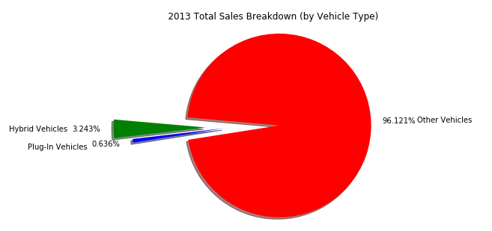
Growth of Hybrid and Electric Vehicle Sales:

Slide 7
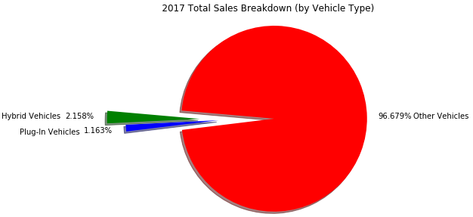
Growth of Hybrid and Electric Vehicle Sales:

Slide 8
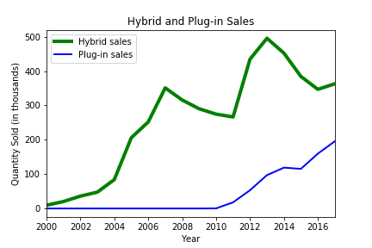
Comparing Sales of Hybrid vs Electric Vehicles:

Slide 9
Summary
We see a small increase in the market share of electric vehicles over time. .
Hybrid vehicles have instable growth patterns, while Plug-in Electric vehicles have had steady, consistent growth since 2010.
Growth points in electric vehicles seem to correlate to debuts in particular models (2010/2011 – Nissan Leaf and Chevy Volt) (2012 – Tesla Model S) (2016-Tesla Model 3).

Slide 10
Internal Market Factors
Do we see increased competition within the electric vehicle market with the growth in sales?
Which car makers have the biggest impact on sales?
Data - Kaggle Contains information about cars used in United States from 1990 to 2017.It includes information like Engine type, Miles per Gallon, Popularity, MSRP for each Model.
afdc.gov Contains information about sales of electric cars in United States from 2011 to 2016 for different brands and models.

Slide 11
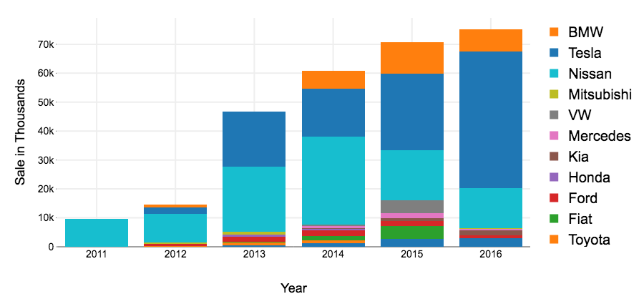
Electric Vehicle Sales by Brand

Slide 12
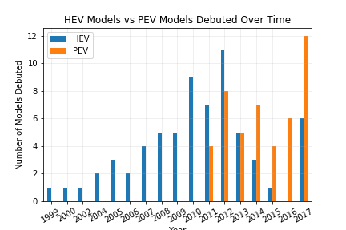
HEV and PEV Model Debuted by Year

Slide 13
Summary
There is an increase in the number of brands producing PEV vehicles that increases with sales.
As sales of PEV vehicles rise, we see the introduction of luxury car makers into the market.
There is a decrease in the release of new HEV vehicles that correlates with the volatility in hybrid vehicle sales.

Slide 14
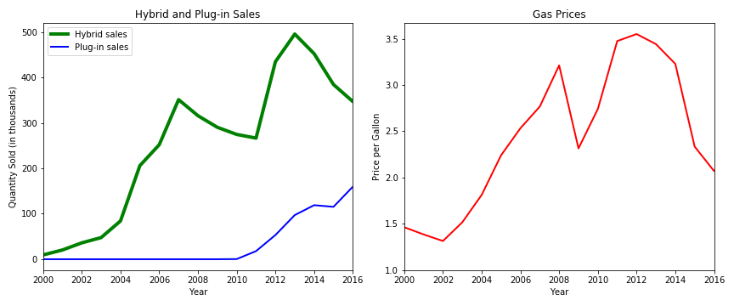
External Market Factors – Gas Prices
Sales of Hybrid Vehicles appears to be heavily linked to gasoline prices.
Electric Vehicle sales were more resilient to changes in gasoline prices.

Slide 15
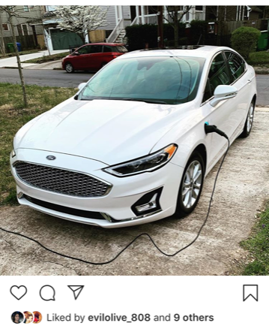
External Market Factors – Charging Infrastructure
What is “Range Anxiety”?
Most people only drive an average of 50 miles per day
The average miles per battery charge is 200.
So what’s the big deal?

Slide 16
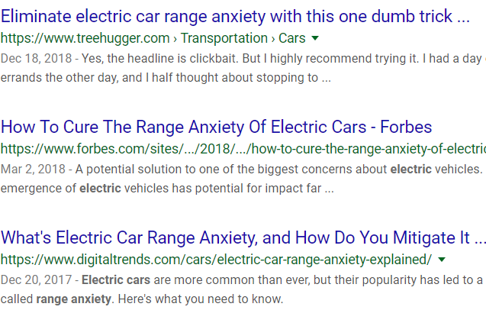
External Market Factors – Charging Infrastructure
If “Range Anxiety” is considered a hurdle to electric vehicle adoption, do we see a correlation between PEV and the spread of charging stations?

Slide 17
Gathering and Cleaning Data
National Renewable Energy Laboratory API for Alternative Fuel Stations https://developer.nrel.gov/docs/transportation/alt-fuel-stations-v1/
Parameters
Type of Fuel Station (Electric Only)
Data Pulled State-By-State
Pulled state abbreviations from the python library “US”
Fields gathered - Date Opened, Access Type, Lat, Long, State

Slide 18
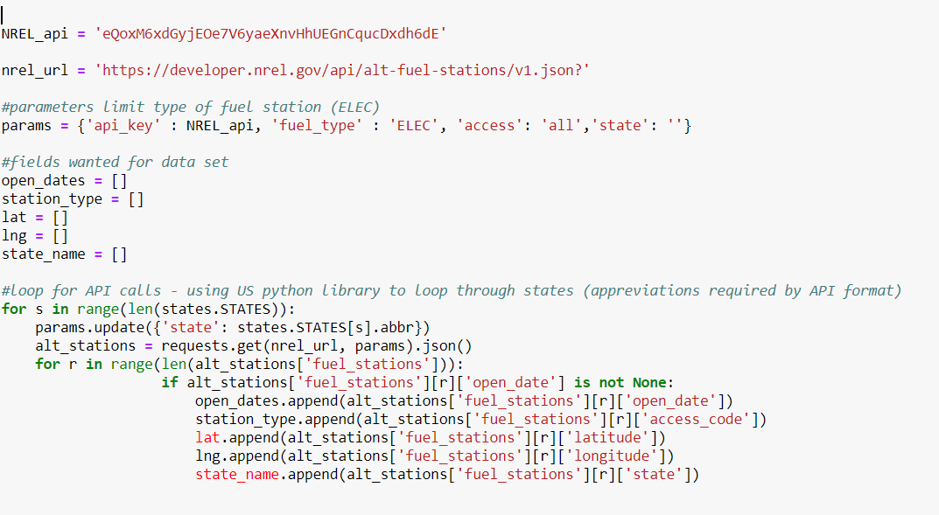
API Call Example

Slide 19
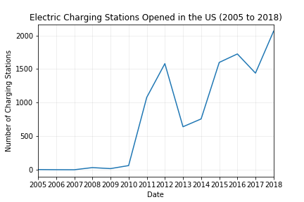

Slide 20
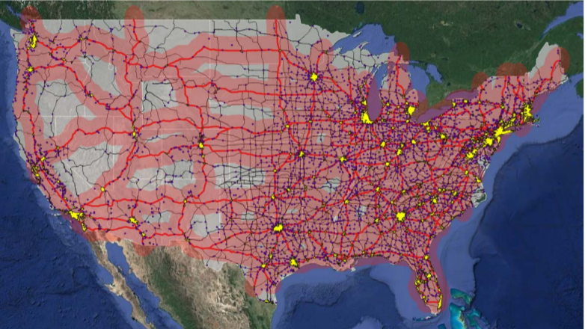
Electric Charging Density in the U.S.
Approximate BEV driving coverage enabled by providing DCFC stations along the U.S. Interstate System from NREL Report on Station Infrastructure

Slide 21
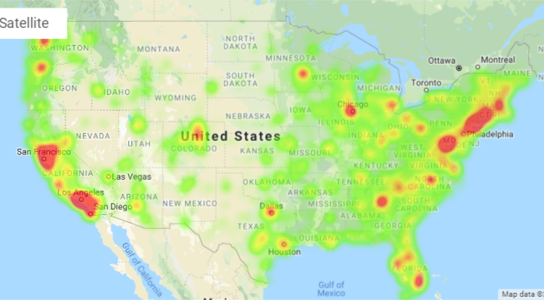
Electric Charging Density in the U.S.

Slide 22
Electric Charging Infrastructure in the U.S.
We see an increase in stations opened that does track with PEV sales.
Station openings slightly lead sales.
Largest jump in openings occurs in 2010 – 2011, where PEV sales begin to take off.
Largest increase in stations opened track to the years that the Nissan Leaf and Chevy Volt were introduced (2010 and 2011 respectively) and peaks at the introduction of the Tesla Model S (2012) and again at the introduction of the Model 3 (2016), suggesting station openings are effected by sales and enthusiasm around new car models.
Current station density is not high enough to connect most areas of the country outside of dense urban areas and the Eastern Seaboard.

Slide 23
External Market Factors – State and Federal Incentives and Regulation
Are sales of electric vehicles effected by incentives (such as tax breaks)?
National Renewable Energy Laboratory API for Alternative Fuel Stations https://developer.nrel.gov/docs/transportation/transportation-incentives-laws-v1/
Parameters
Electric, Plug in Electric, or Hybrid Vehicles
Must include provisions that effect individuals (IND parameter key)

Slide 24
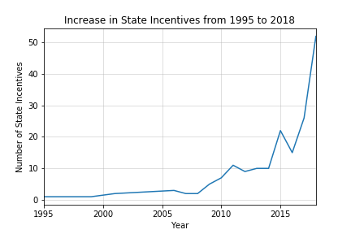
State and Federal Exemptions for Electric and Hybrid Vehicles

Slide 25
Summary
There is a rise in incentives passed at the state and federal level and the rise in PEV sales.
There are some limits to the data.

Slide 26
Four Major Air Pollutants & AQI
Nitrogen Dioxide (NO2)
Form Ozone and can cause lung irritation
Sulphur Dioxide (SO2)
Product of burning sulfur-containing fuels
Carbon Monoxide (CO)
Formed by the combustion of fossil fuels. When inhaled, blocks oxygen from the brain, heart, and other vital organs
Ozone (O3)
Main component of smog and is the product of sunlight and emissions from sources such as motor vehicles and industry
Air Quality Index (AQI)
The higher the AQI value, the greater the level of air pollution.
AQI values are generated for each of the major pollutants, and the highest value is reported daily as an indicator of air quality for that day
Source: https://airnow.gov/index.cfm?action=aqi_brochure.index
https://www.ucsusa.org/clean-vehicles/vehicles-air-pollution-and-human-health/cars-trucks-air-pollution

Slide 27
Data Cleanup & Exploration
US Air Pollution data (2000-2016) via Kaggle
Read CSV into a pandas DataFrame
Get rid of unnecessary data
Handle multiple records for same day (measured in morning and afternoon)
Separate data by Year, and return max AQI value for each pollutant by Year
Using Cartopy, create a US Map Figure while color coding shape based on AQI value for a given year
Using matplotlib, leverage FuncAnimation to create animation that shows Max AQI values for each year from 2000-2016
Repeat for each air pollutant

Slide 28
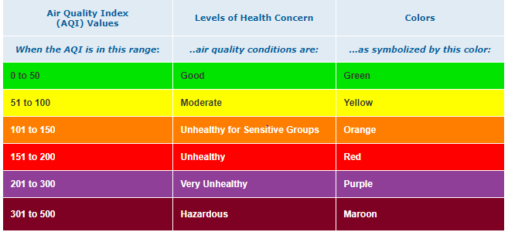
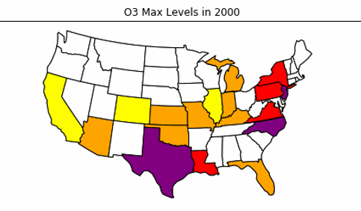
Air Quality Index (AQI) by State & Pollutant
Source: https://airnow.gov/index.cfm?action=aqibasics.aqi

Slide 29


Slide 30
Findings

Slide 31
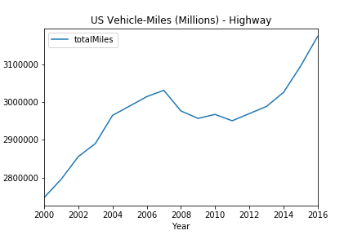
US Vehicle-Miles Trend
Miles traveled via ground vehicles (highway) within the US has increased steadily since 2000
This indicates a negative correlation between air pollution levels and vehicle miles traveled – does this make sense?
Based off this analysis, our next inference would be that the growth of Hybrid/EV sales is dropping pollution levels despite a growth in miles traveled via ground vehicles
Data source: https://www.bts.gov/content/us-vehicle-miles

Slide 32
Post Mortem
There is an increase in sales and market share of Plug-in Electric vehicles, while sales of Hybrid vehicles seem to be in decline.
Internal market factors
There is an expansion of offerings by US and Global car makers in the PEV market, driven in part by enthusiasm surrounding particular brands, such as Tesla.
External market factors
Gas prices have a large impact in HEV sales and almost no impact on PEV sales, suggesting PEV buyers are driven by other factors.
The availability of electric charging stations is on the rise, but mostly in the Eastern US, California and Urban centers.
Incentives track to the increase in sales, but it is inconclusive as to which types of incentives have the largest impact.
The Air Quality index of the US has improved along with the increase in electric vehicles sales, despite the fact that Americans are driving more miles overall.

Slide 33
Q&A

